Slide 1
Outreach to Global Decision-makers: Lessons Learned since Rio 1992
Kimo Goree kimo@iisd.org
Director – Reporting Services
International Institute for Sustainable Development (IISD)
Notes:
IISD

Slide 2
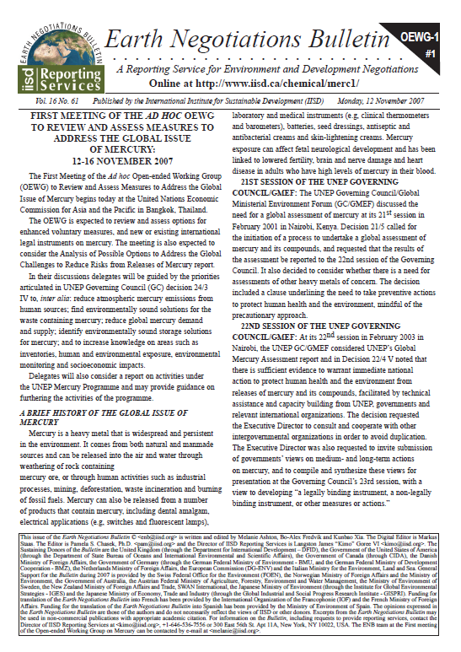
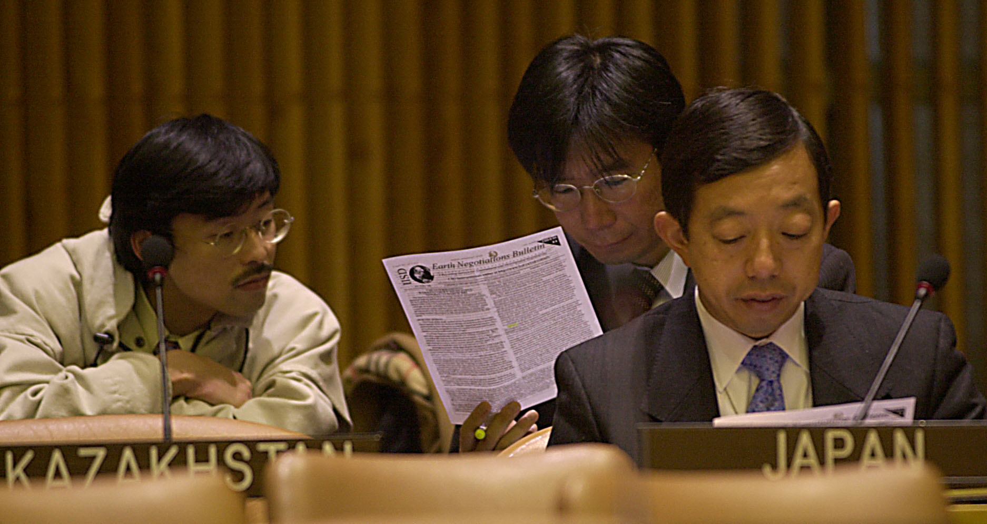
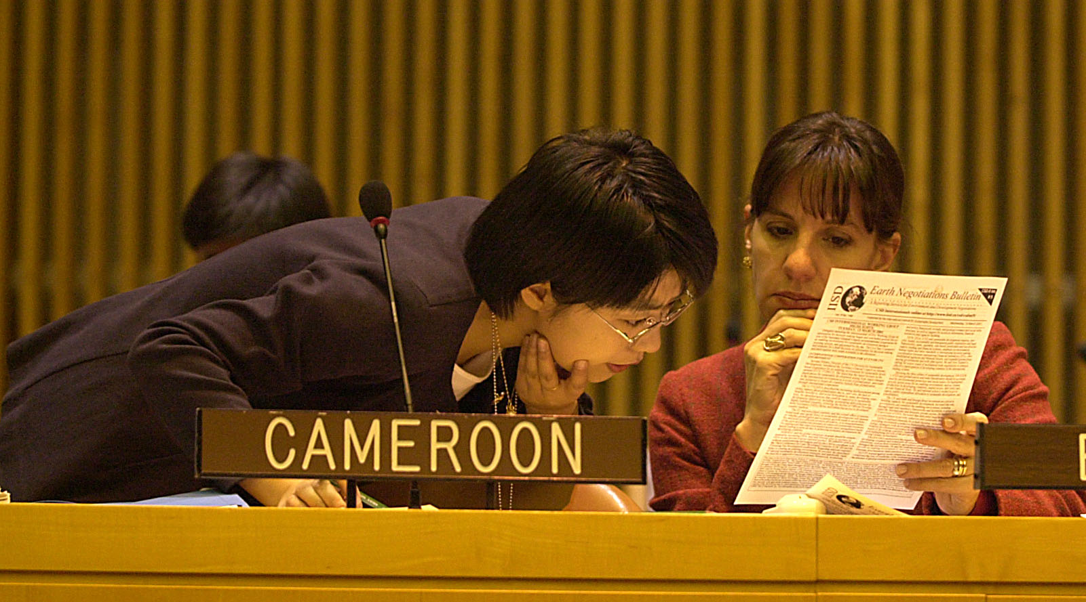
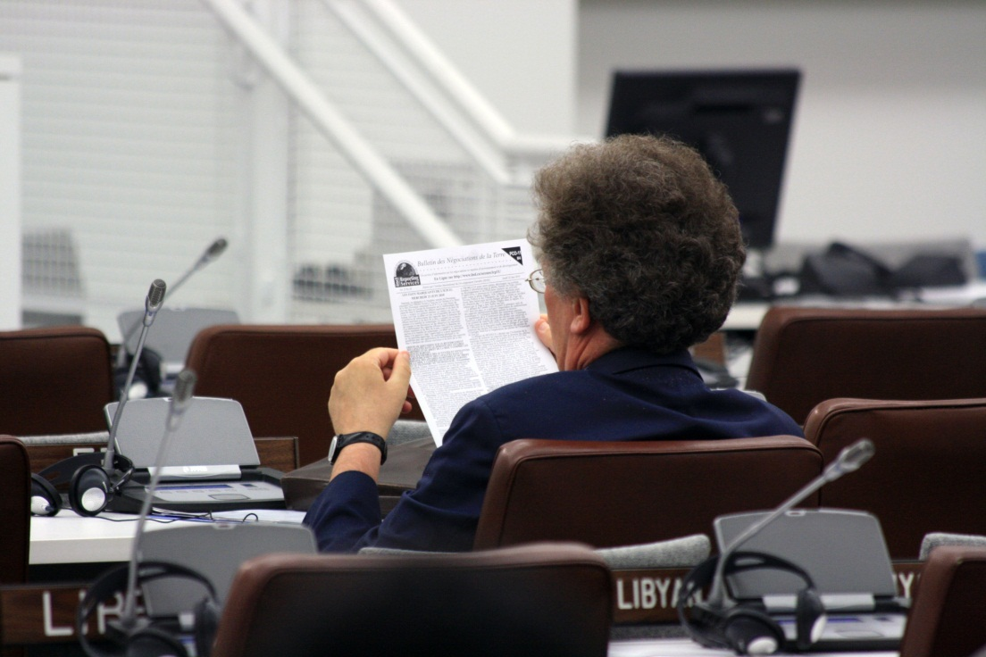
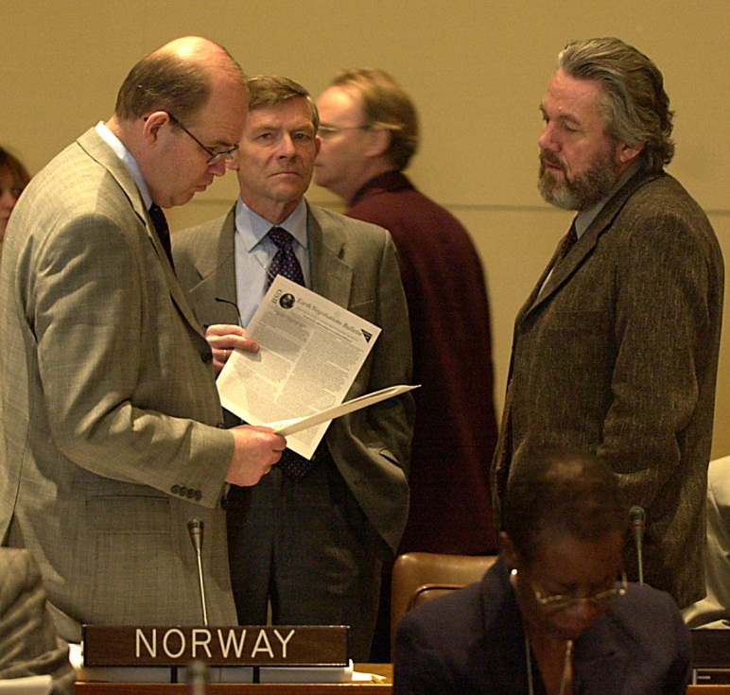
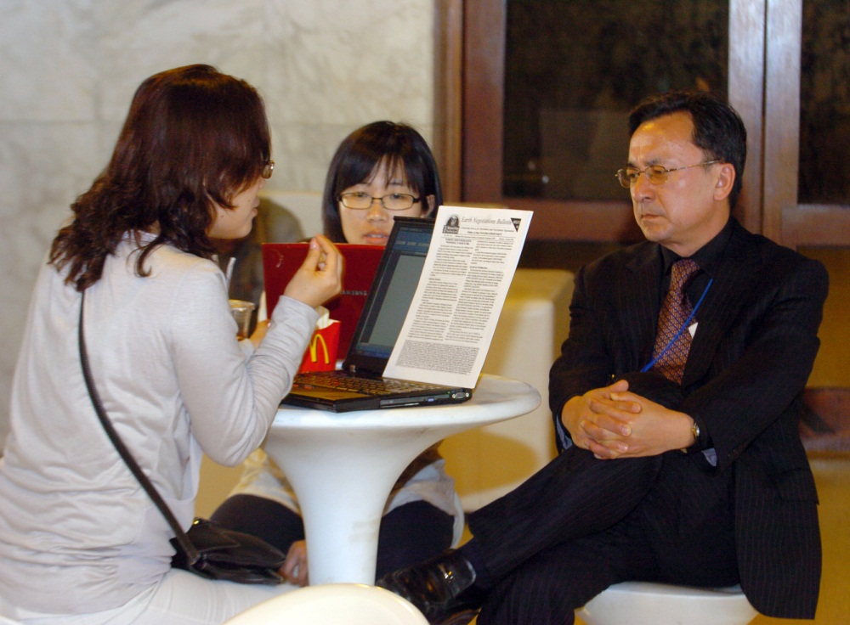
ENB
Notes:
Over the last twenty-three years, our publication, “The Earth Negotiations Bulletin” has provided a neutral, authoritative source of information on international negotiations in the areas of climate change, biodiversity, desertification, chemical management and reports from ocean-related meetings including the UN Open-ended Informal Consultative Process on Oceans and the Law of the Sea and the Ad Hoc Open-ended Informal Working Group to study issues relating to the conservation and sustainable use of marine biological diversity beyond areas of national jurisdiction (BBNJ)

Slide 3
IISD: KM for Policymakers
“It’s not information overload. It’s filter failure.”
― Clay Shirky
Notes:
We do not have a problem of too much information. Too much information is a great thing. What we don’t have, according to Clay Shirky, one of the leading thinkers on information management, is filter failure. We all use filters to help us find signal through the noise, whether we see them as filters or not. Our organization IISD has become one of the leading filters for policy makers wo trust us as knowledge brokers, the trusted neutral information providers who synthesize huge amounts of information, curating out the items that are important from the rest and providing it to them in easy to access packages.

Slide 4
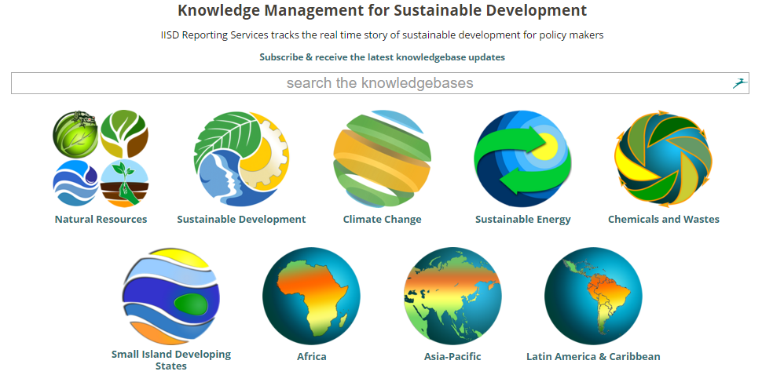
IISD: KM for Policymakers
Notes:
Since 2005 we have expanded our work, curating knowledge for policymakers on the activities taking place between multilateral negotiations and distributing this content through open community lists, including CLIMATE-L and OCEANS-L.

Slide 5
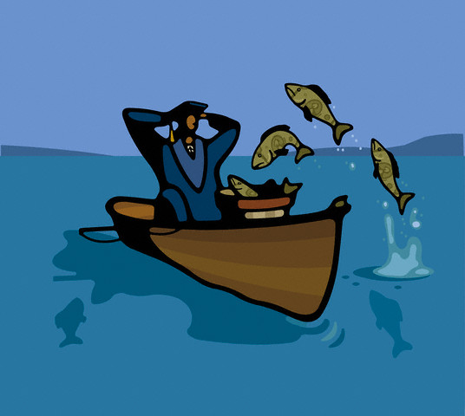
IISD: KM for Policymakers
Lessons Learned
Notes:
It’s not buy a man a fish or teach a man to fish. It’s teach the fish to jump in the boat.
One of the most important lessons that we have learned is to partner with organizations help them to use our networks to share their best and worst practices.

Slide 6
Lessons Learned
IISD: KM for Policymakers
Human curation
Knowledge needs networks to avoid being static
Open networks create institutional rewards
Neutral provision of information
Notes:
We have learned that good knowledge management requires curators who recognize good information and can transform it into knowledge
We have learned that creating knowledge isn’t enough.. You also need to develop the networks to distribute it
We have learned that openness, sharing and generosity with information and your networks brings institutional rewards.. A network of goodwill that can sustain organizations
We have learned that neutrality is the only sustainable strategy as a knowledge broker

Slide 7
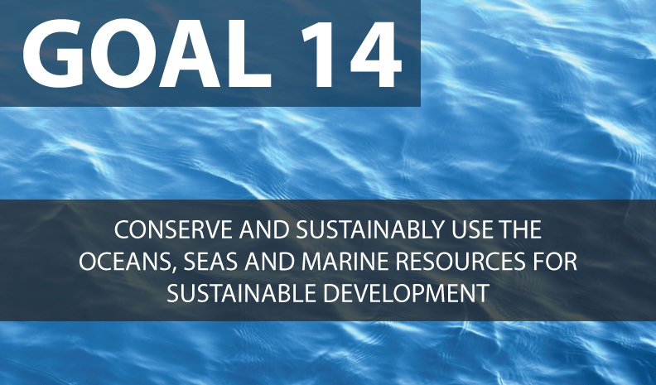
Knowledge for SDG14
IISD: KM for Policymakers
Beyond measurement and indicators – tracking the narrative
Building the practice community
IISD Reporting Services ready to assist in tracking Goal 14 – expansion of OCEANS-L
Notes:
What advice would you give the ocean community?
We need to begin building immediately a tracking system for Goal 14. It will take two years for the quantitative measurement and indicators for this goal to come online. We need to begin telling the story immediately .. The narrative of implementation
And, we need to expand our community of practice.. The knowledge and practice community around Goal 14.
IISD, with our networks, stands ready to assist the Oceans community in building this system.

Slide 8
Thank you
IISD Reporting Services (IISD RS) is a division of the International Institute for Sustainable Development. IISD RS was established in 1997 to include the growing number of hard copy and electronic (on-line) products created by the staff of the Earth Negotiations Bulletin (ENB).

